Slide 1
Information Technology and the increasing rate of academic collaboration
Avi Goldfarb, University of Toronto and NBER
November 2014

Slide 2
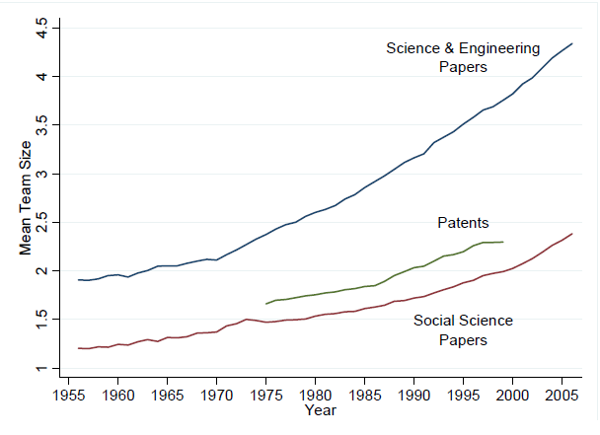
Research Teams: Increase in Size and Impact
Broad trend of increase in research team size across academic fields and subfields
Jones (2010)

Slide 3
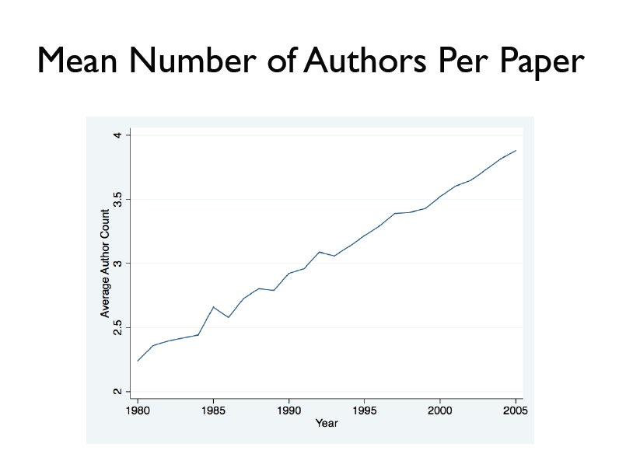

Slide 4
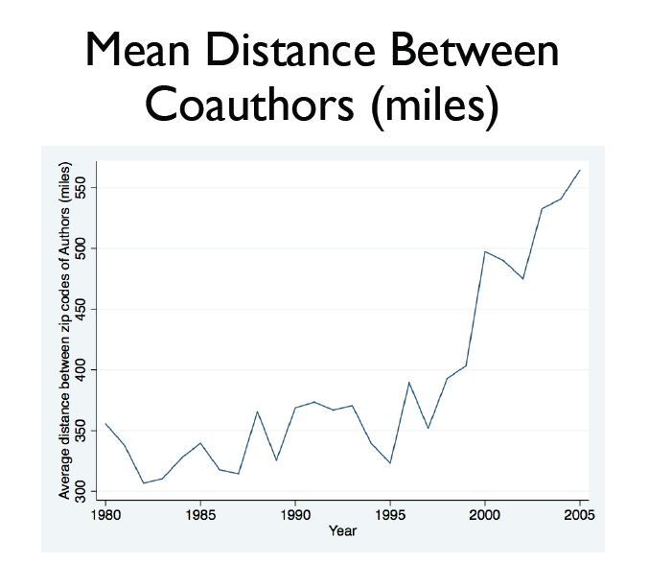

Slide 5
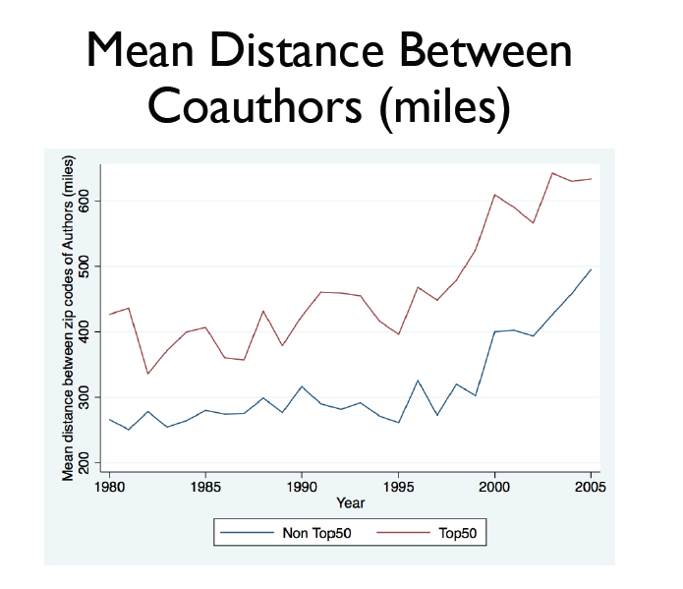

Slide 6
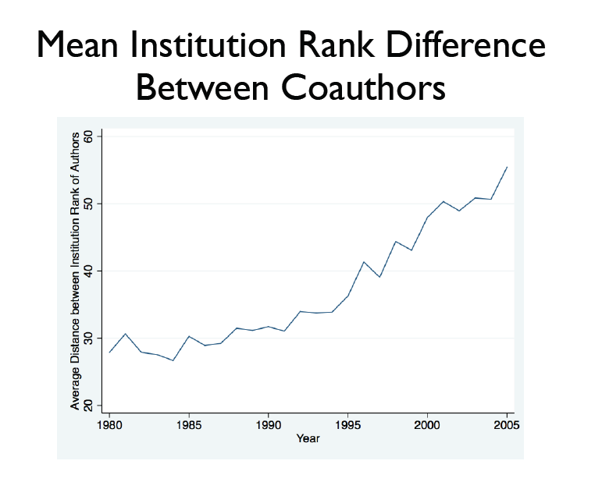

Slide 7
A dominant theme in the economics of innovation
“Our study suggests that the increase in US patents in China and India are to a great extent driven by MNCs from advanced economies and are highly dependent on collaborations with inventors in those advanced economies.” Branstetter, Li, and Veloso
“We show that these [geographic distribution of inventive activity] results are largely driven by patents filed by distant collaborators rather than by non-collaborative patents or patents by nondistant collaborators...” Forman, Goldfarb, and Greenstein
“Much of the equipment associated with these shifts in logic were, although expensive, still affordable at the lab or institutional level. Some, however, such as an NMR, carried sufficiently large price tags to encourage, if not demand, collaboration across institutions.” Stephan
“Collaborations with other scientists, as measured by the number of coauthors on a paper, have increased. This increase is driven by collaborations with scientists outside of a trainee’s laboratory.” Conti and Liu
“The major factor cited for all types of collaborations was ‘unique knowledge, expertise, capabilities.’ Non-colocated and international teams were more likely to have a coauthor contributing data, material or components - a pattern that has been increasing over time...” Freeman, Ganguli, Murciano-Goroff

Slide 8
Hypotheses behind increasing team size
Increasing capital intensity
Shifting authorship norms
Increasing competition
Knowledge burden hypothesis
Declining communication costs

Slide 9
Hypotheses behind increasing team size
Increasing capital intensity
Shifting authorship norms
Increasing competition
Knowledge burden hypothesis
Declining communication costs

Slide 10
Hypotheses behind increasing team size
Increasing capital intensity
Shifting authorship norms
Increasing competition
Knowledge burden hypothesis
Declining communication costs

Slide 11
Agrawal and Goldfarb. 2008. Restructuring research: Communication costs and the democratization of university innovation. American Economic Review.

Slide 12
Research Questions
How do changes in collaboration costs affect the process of knowledge production?
  Did researchers at US universities connecting to Bitnet, an early version of the Internet, increase multi-institutional collaboration? If so, by how much?
  Did all universities that connected benefit equally?
    Quality: What is the role of top-tier relative to middle-tier institutions? Is the division of labor in knowledge production sensitive to communication costs?
    Distance: Is electronic communication a substitute or compliment for face-to-face interaction in the context of research collaboration? Do lower communication costs lead to the “death of distance” in terms of collaboration, or amplify agglomeration tendencies?

Slide 13
Main Findings
We exploit the variation in year of adoption and publication output over time in the 270 universities that published in seven top electrical engineering journals from 1981 to 1991
We find that a Bitnet connection did seem to facilitate a general increase in multi-institutional collaboration (by 40%, on average)
But, not all adopters benefited equally:
  Bitnet seems to have facilitated a disproportionate increase (133%) in the role of second-tier universities, particularly those co-located with top-tier institutions.

Slide 14
Bitnet – a brief history
Bitnet was an early leader in network communications for the research and education community.
  Email, FTP, listserv, etc.
  “The IT director made the decision to actually make the connection”
  “At its peak, Bitnet had millions of users”
Our Bitnet data spans the period 1981-1990.
  The first mass-market browser, Mosaic, was developed in 1993.
Networks:
  ARPANET, EDUNET, CSNET, USENET were all founded for specialized purposes that served small number of schools, and a small number of researchers within those schools.
  BITNET (1981) was created to promote the tools of computer networking for all scholars
  Ira Fuchs, one of the founders of Bitnet, said:
    “We created Bitnet to democratize connectivity.”

Slide 15
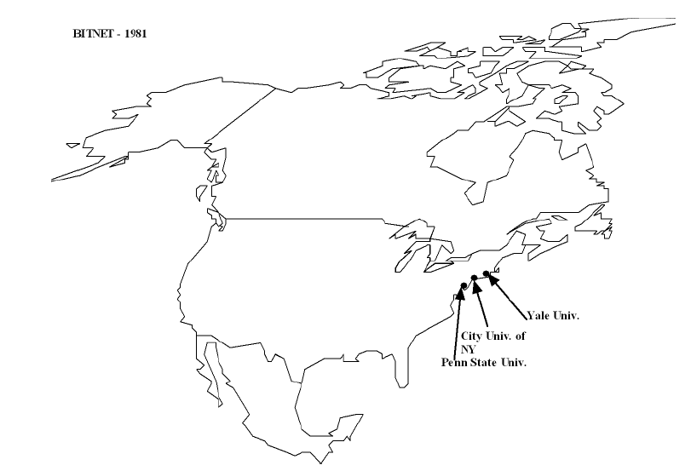

Slide 16
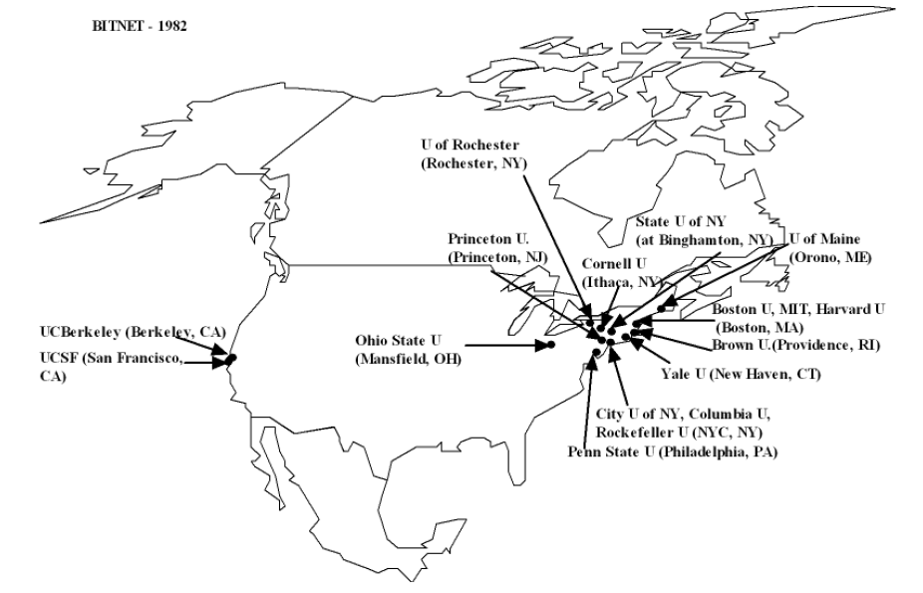

Slide 17
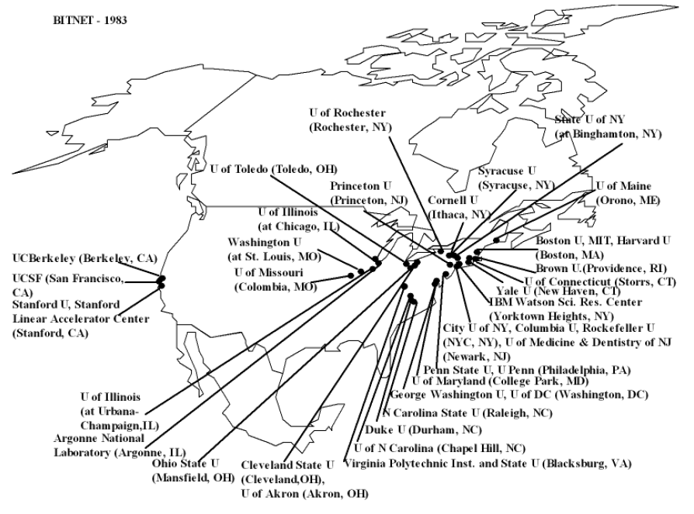

Slide 18
Bitnet facilitates collaboration

Slide 19
The Main Effect Collaboration rates do not rise prior to adoption

Slide 20
Who’s Collaborating?
  Bitnet increase collaboration between tier 1 and tier 2 schools. Harvard-Northeastern more than Harvard-MIT.
  Tier 2 schools became more productive.
  Early on, it was collocated schools.
  Early IT led to a “democratization” of innovation. It enabled researchers at second tier schools to participate in cutting-edge research through collaboration.

Slide 21
What about patents?
Forman and Van Zeebroeck (2012) examine the impact of basic internet technology on collaborative patents
  Internet increases collaborative patents, but for geographically dispersed teams.
Forman, Goldfarb, and Greenstein (2014) shows that advanced internet adoption is correlated with increase in long distance collaborative patents. Internet seems to be mitigating an overall agglomeration effect in patenting.
Overall, improvements in information and communication technology have led to more collaboration, enabling more isolated individuals (by institution quality or by location) to innovate more.

Slide 22
Thank you

